Slide 1
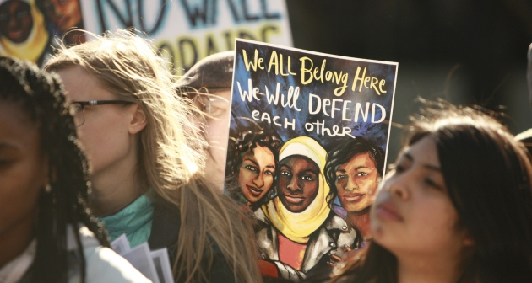


Community competition to prevent islamophobia

Slide 2

Thank YOU!
Drs. Amira Mashhour & Modupe Labode,
Selection Committee Members
Indiana University School of Liberal Arts
Bill & Gail Plater
Lauryn Andrews
Alicia Anino & IUPUI University Library
… and all our community partners!
Notes:
*Out of School excursions

Slide 3
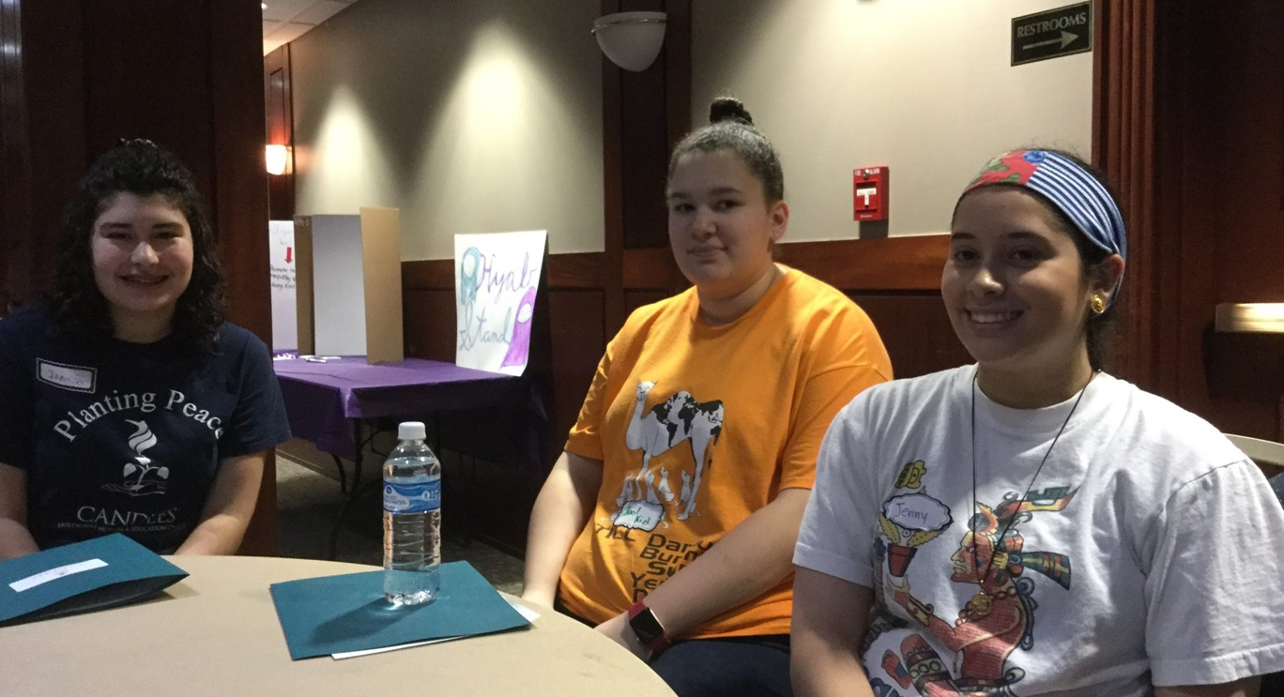
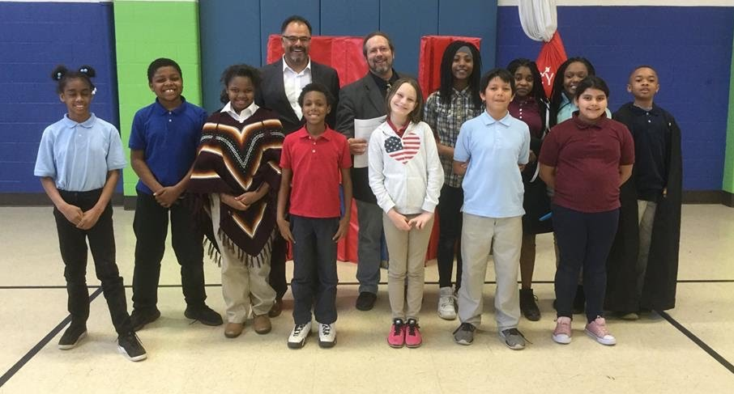
How IT ALL Started
$1,000 awards for the best idea to prevent Islamophobia, or anti-Muslim bias, discrimination, and violence in greater Indianapolis
Highly original projects were required. Collaborations between Muslims and non-Muslims were encouraged.
Notes:
Add photos of the first days of school – or the first weeks. Include a first day quote from students if you have them.

Slide 4
Schedule
9:15 -10:15 Presentations by Winners
Islamophobia Prevention Youth Workshops, by CANDLES Holocaust Museum
Youth Photography Project, by Downey Street Church & Islamic Society of North America
Training Muslim Youth to Challenge Islamophobia, by American Friends Service Committee & Muslim Youth Collective
Muslim Folklore Theater Workshop for Children, by Kristopher Steege and Hadeiyah Ameen
Displaying Local Muslim Poetry, by Brick Street Poetry & Sajjad Jawad
10:15 Networking: Meet the Award Winners & Brainstorm What to Do Next
11:00 Lunch
11:30 – 1:00 Keynote Speech: “The Roots of Islamophobia and What You Can Do About It” By Prof. Hatem Bazian, University of California Berkeley & Zaytuna College

Slide 5

A Matter of Perspective:
Islamophobia Awareness and Prevention Workshops
Sponsored by CANDLES Holocaust Museum and Education Center Youth Board of Directors

Slide 6
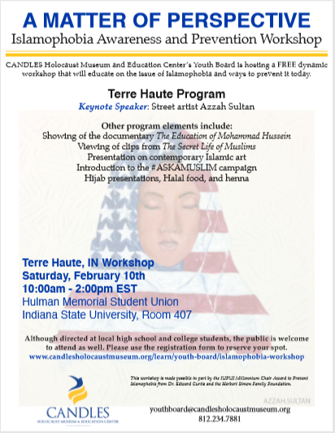
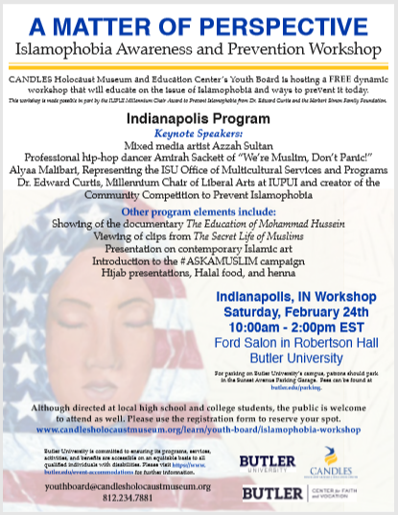
goals
Focus on similarities and differences
Bring fun and engaging speakers!
Be contemporary, relatable, and focused on a young audience
Discuss reasons for hate and discrimination
Develop other ways to prevent acts of hate and create understanding

Slide 7
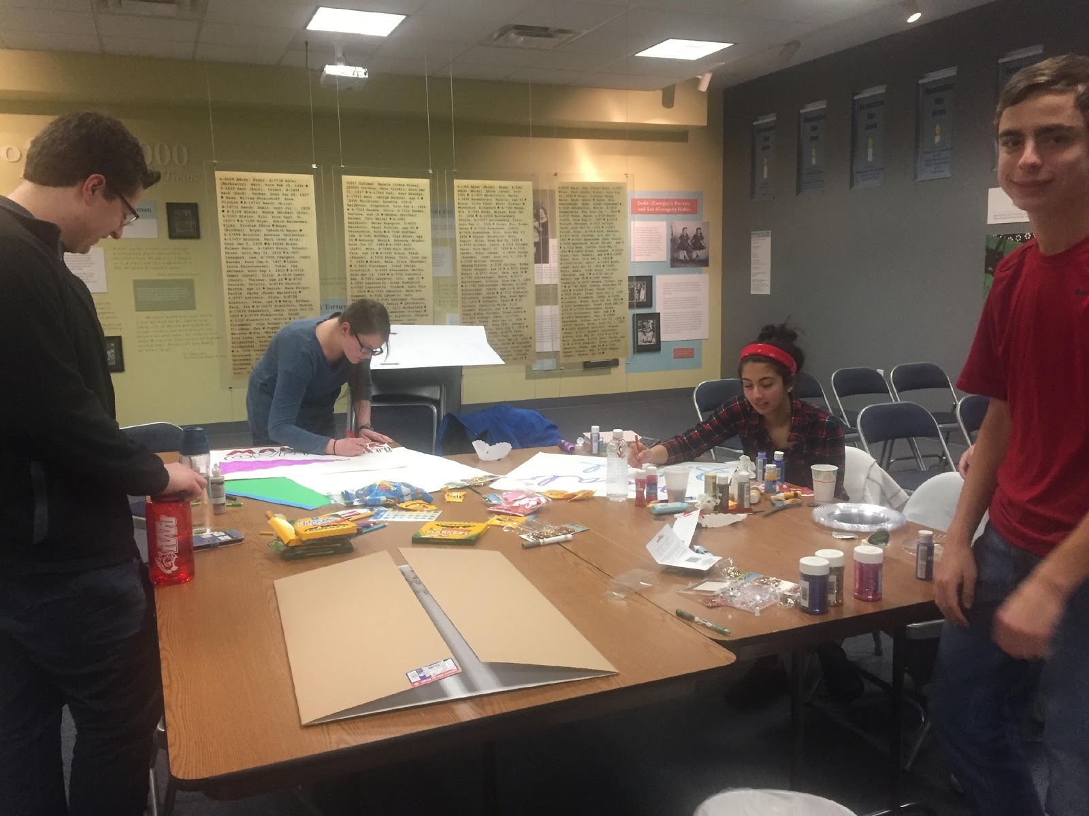

Slide 8
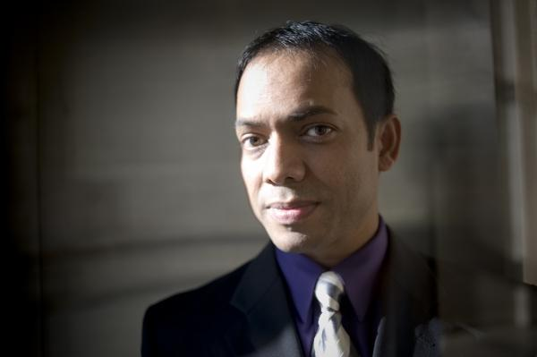
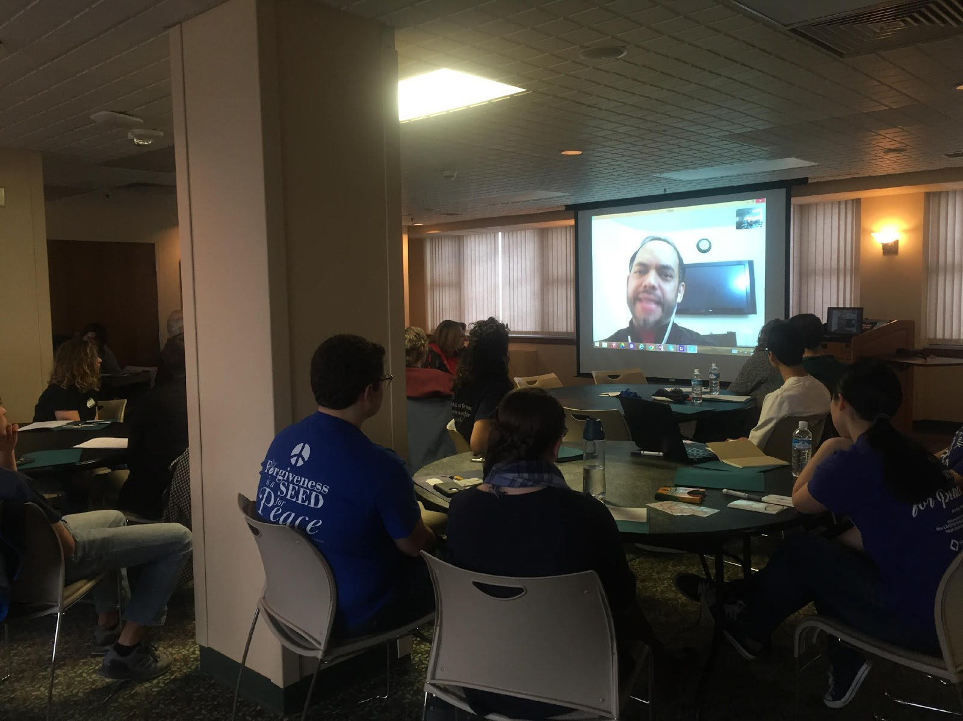
RAIS
BHUiyAN
Founder of World Without Hate
Victim of anti-Muslim hatred who chose to forgive

Slide 9
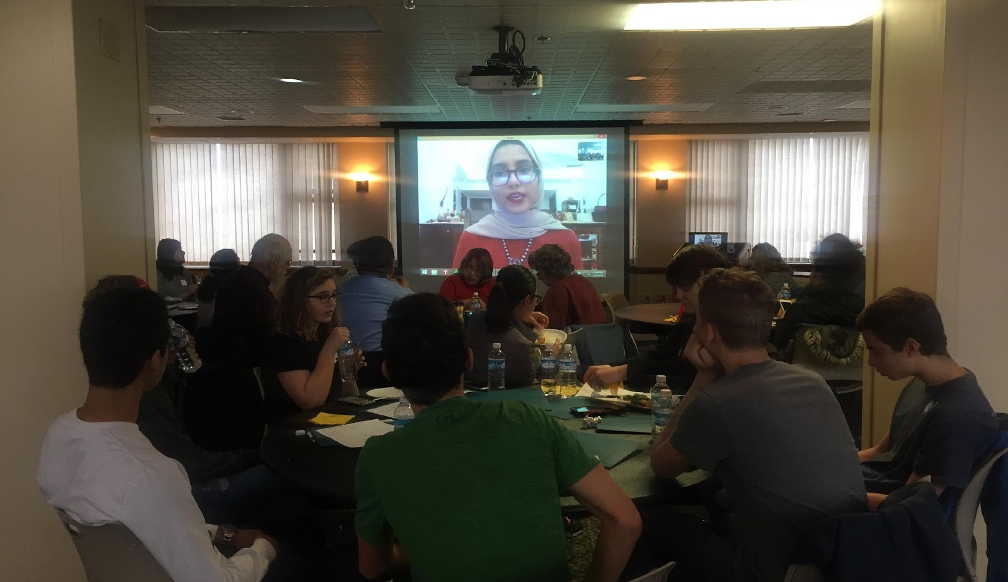
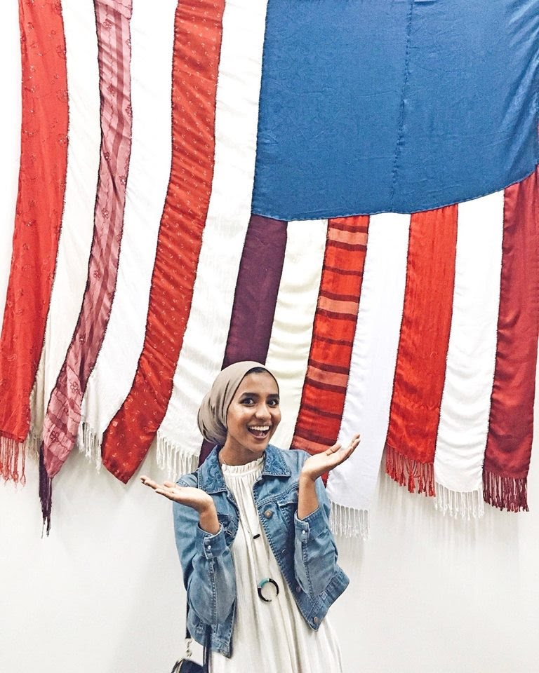
AZZAH SULTAN

Slide 10
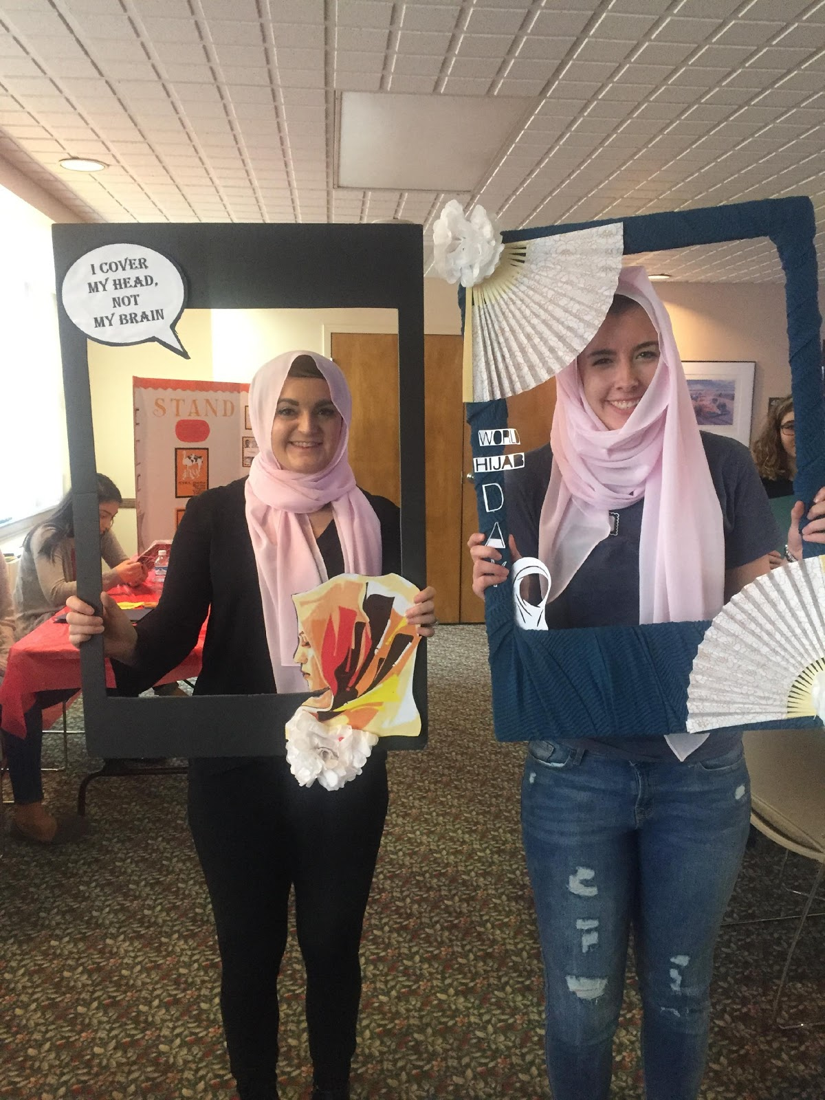
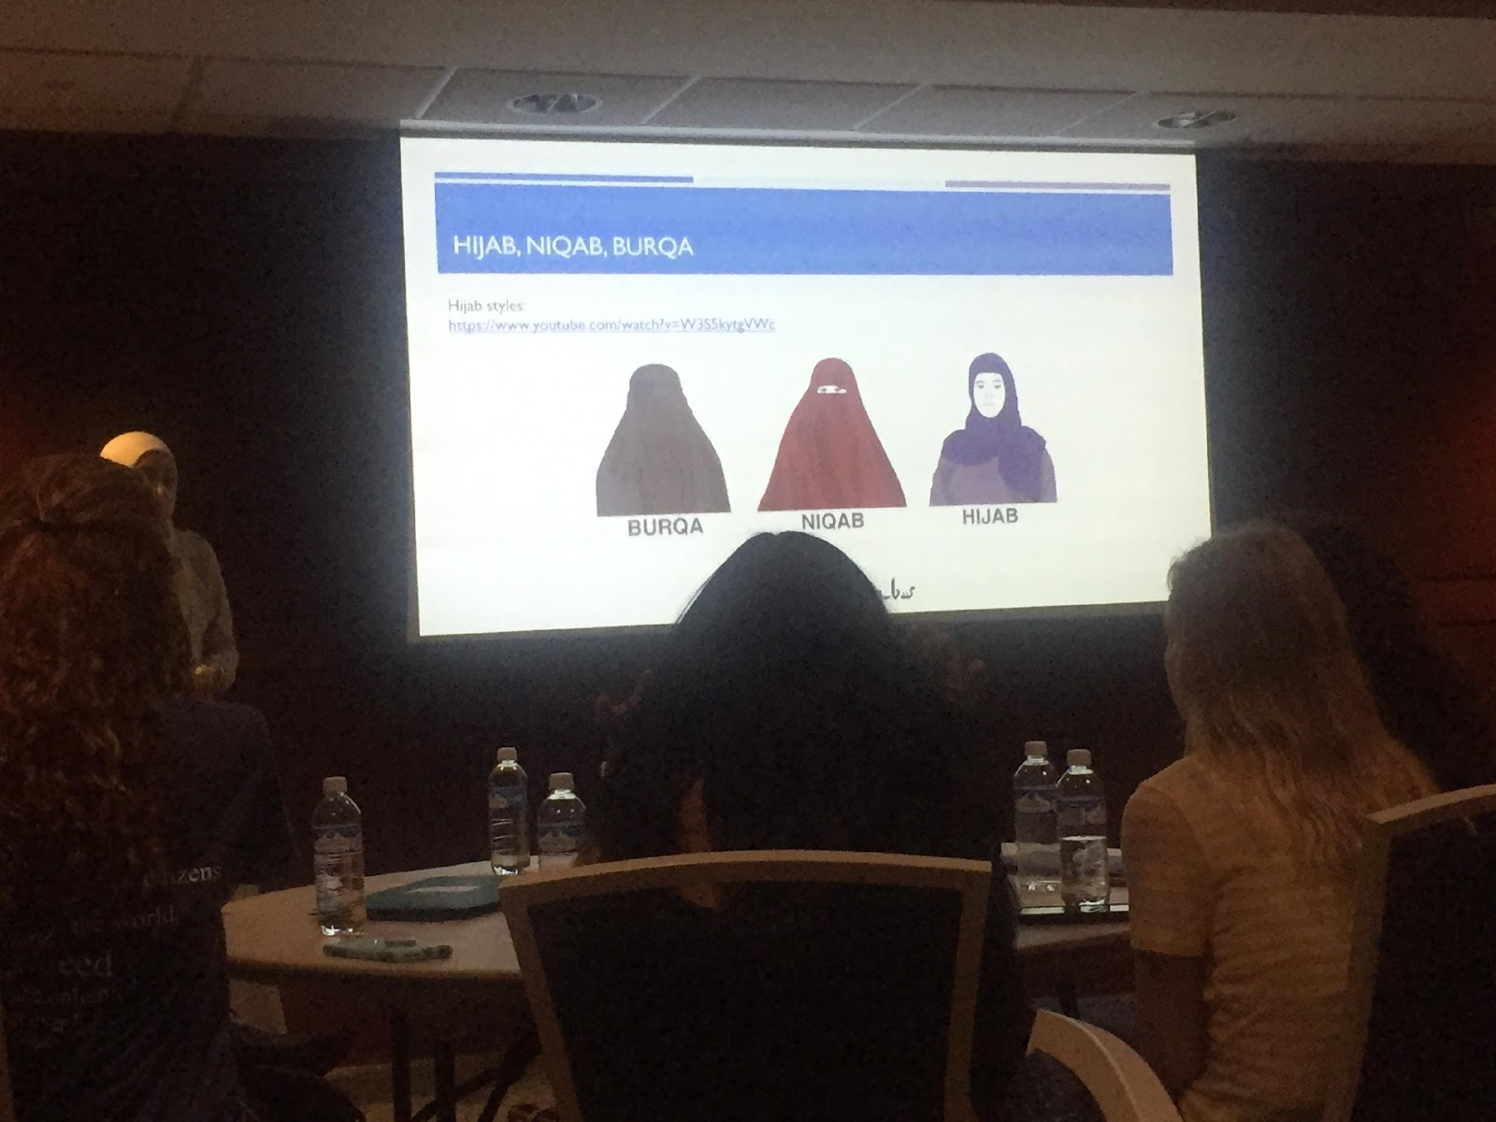
I cover my head, not my brain

Slide 11
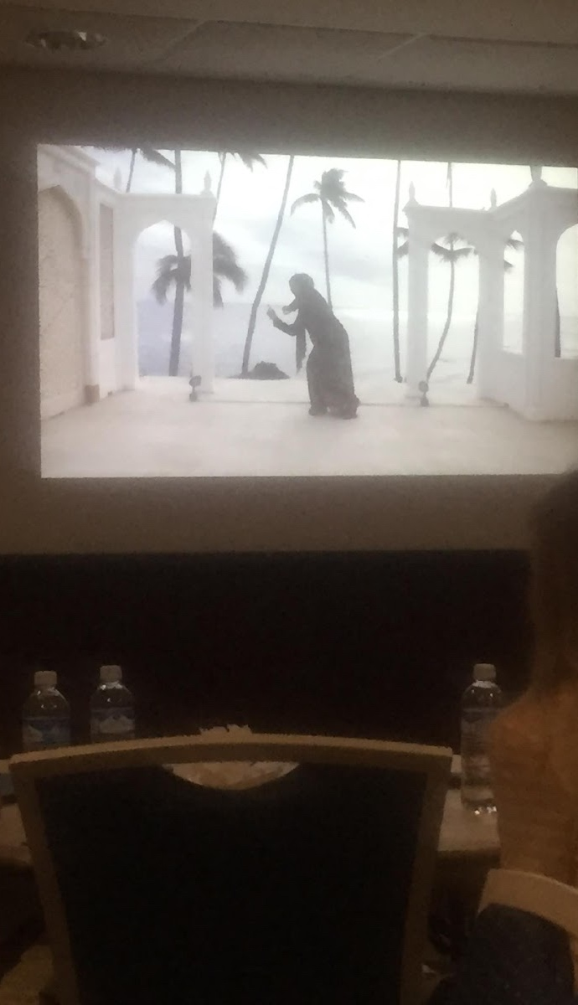
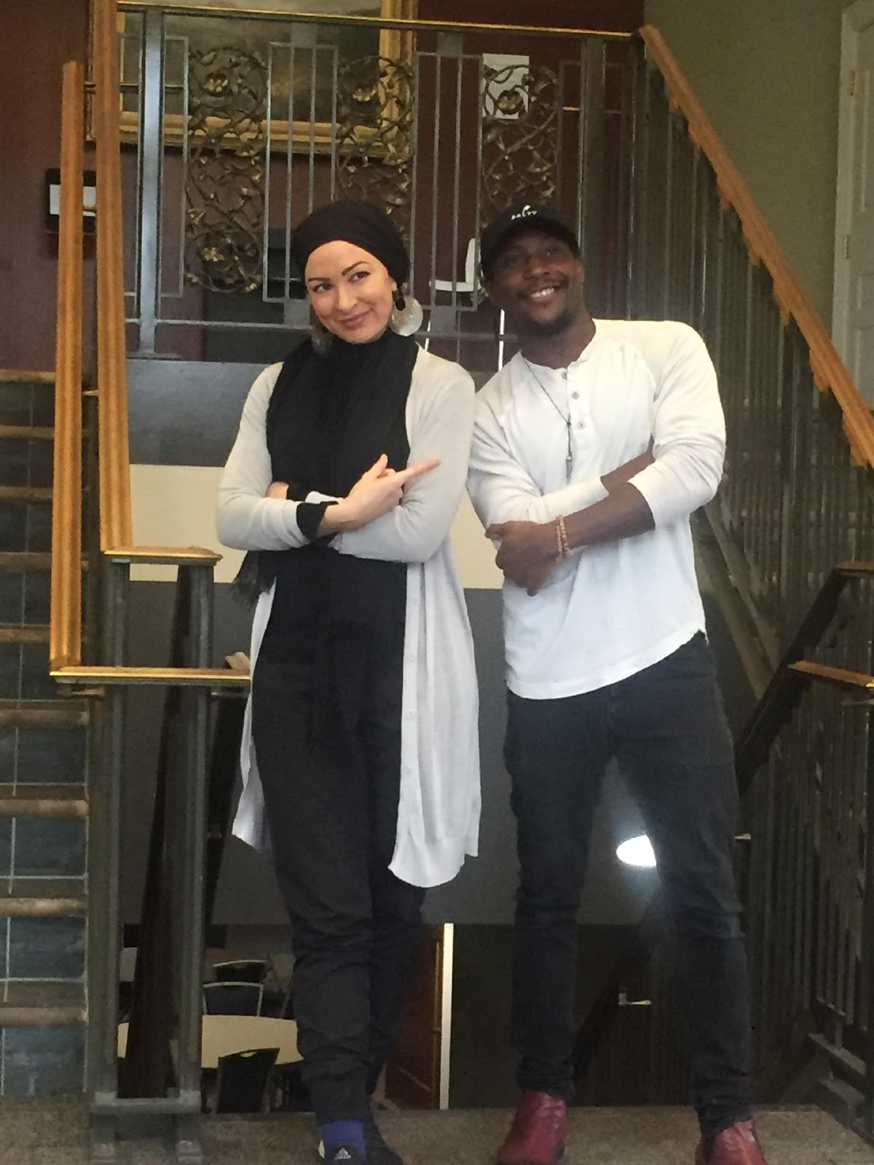
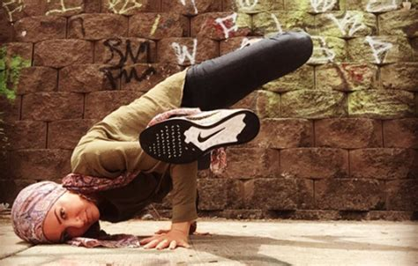
Amirah sackett
Hip Hop Dancer
Choreographer
Teacher

Slide 12
What’s next
The 2018-2019 CANDLES Youth Board of Directors is hoping to plan a similar workshop in the coming year but looks at bringing together anti-Semitism and Islamophobia to help create a further dialogue of understanding and peace.
CANDLES is hosting Rais Bhuiyan at the museum on November 15th to share his story in person.
We would also like to host Amirah again, as her dancing was the highlight of the workshops!
Our Youth Board of Directors is looking for local organizations to meet with to help further their reach to fight Islamophobia and educate on our similarities and differences in a respectful environment.

Slide 13
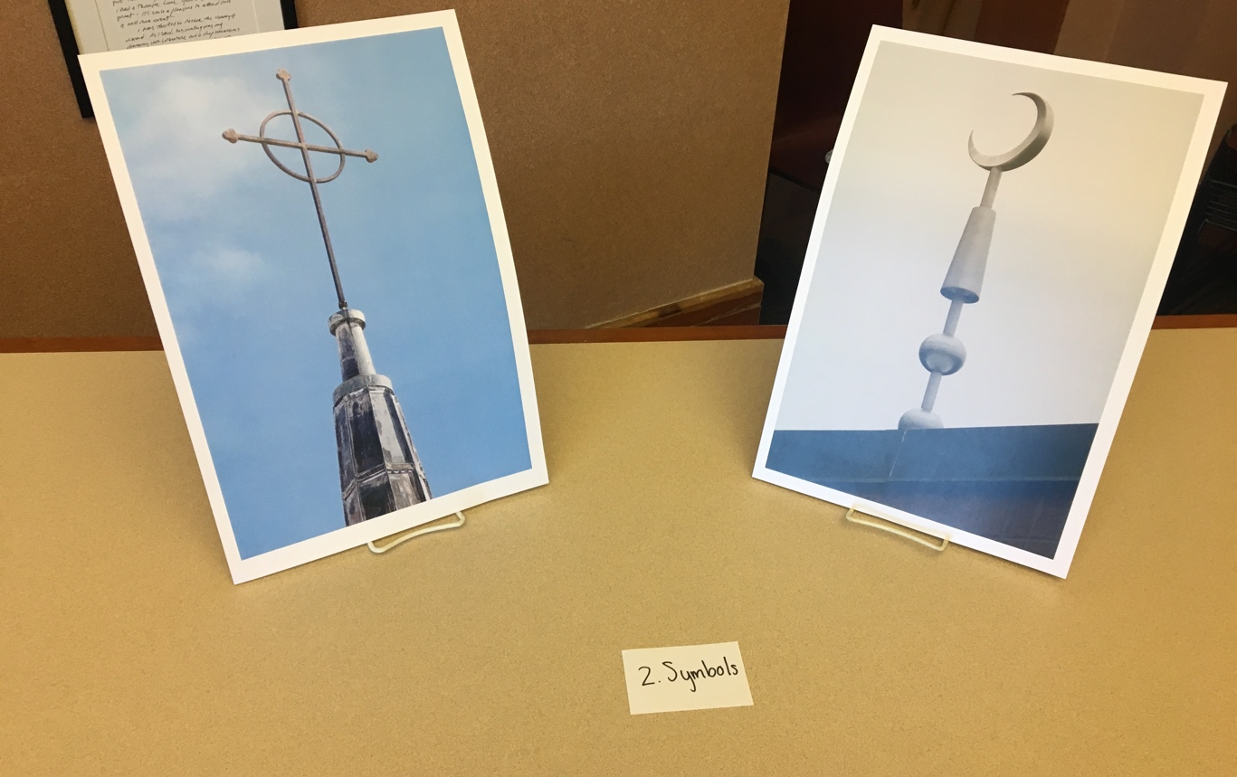
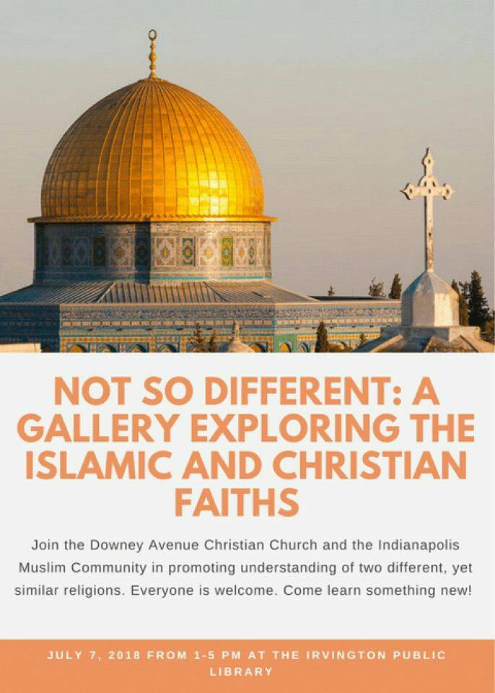
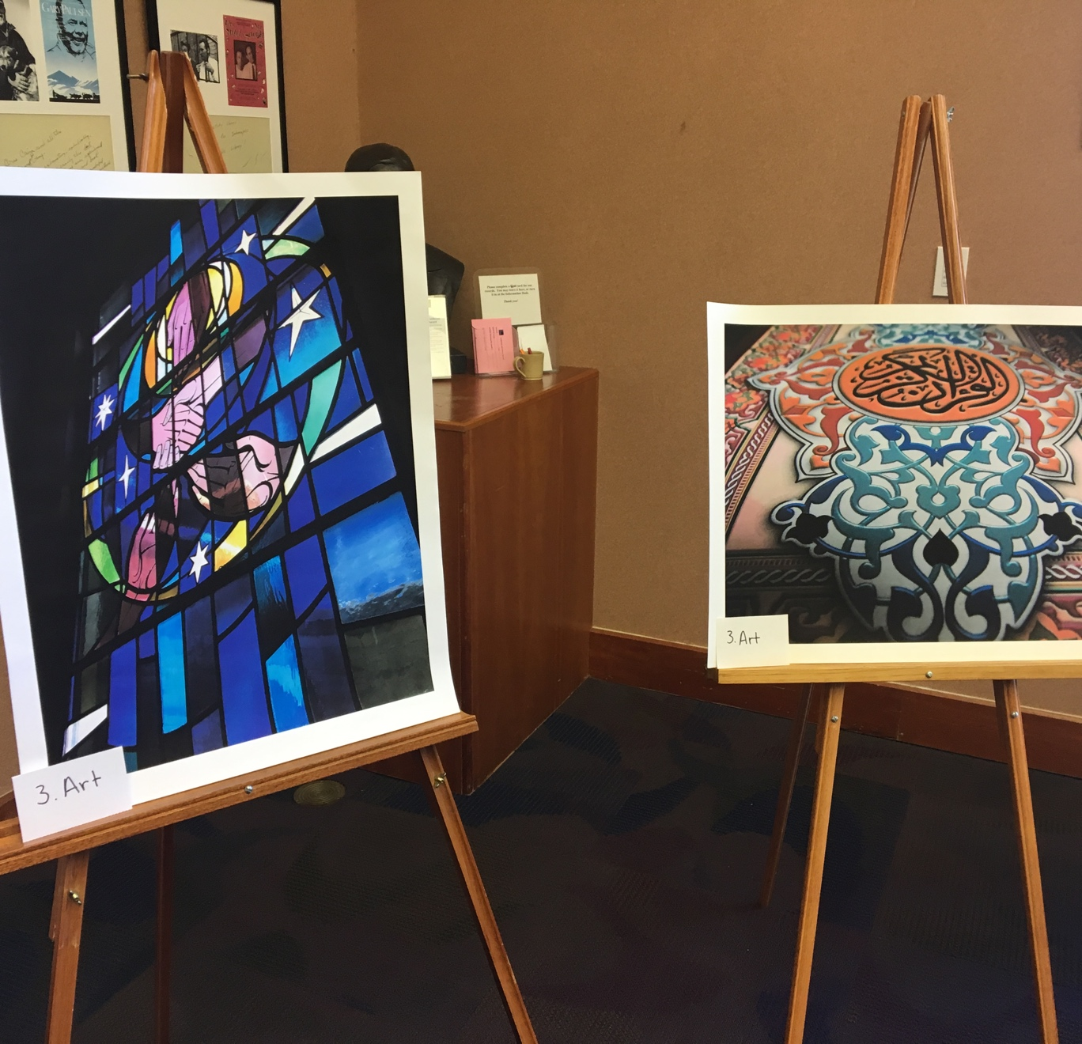
YOUTH
PHOTO project
Islamic Society of North America
Downey Avenue Christian Church
Notes:
*Change to Summer Times for Southern Hemisphere
Add pictures of student work here – projects they’ve completed; a collage of pictures would be a great idea

Slide 14
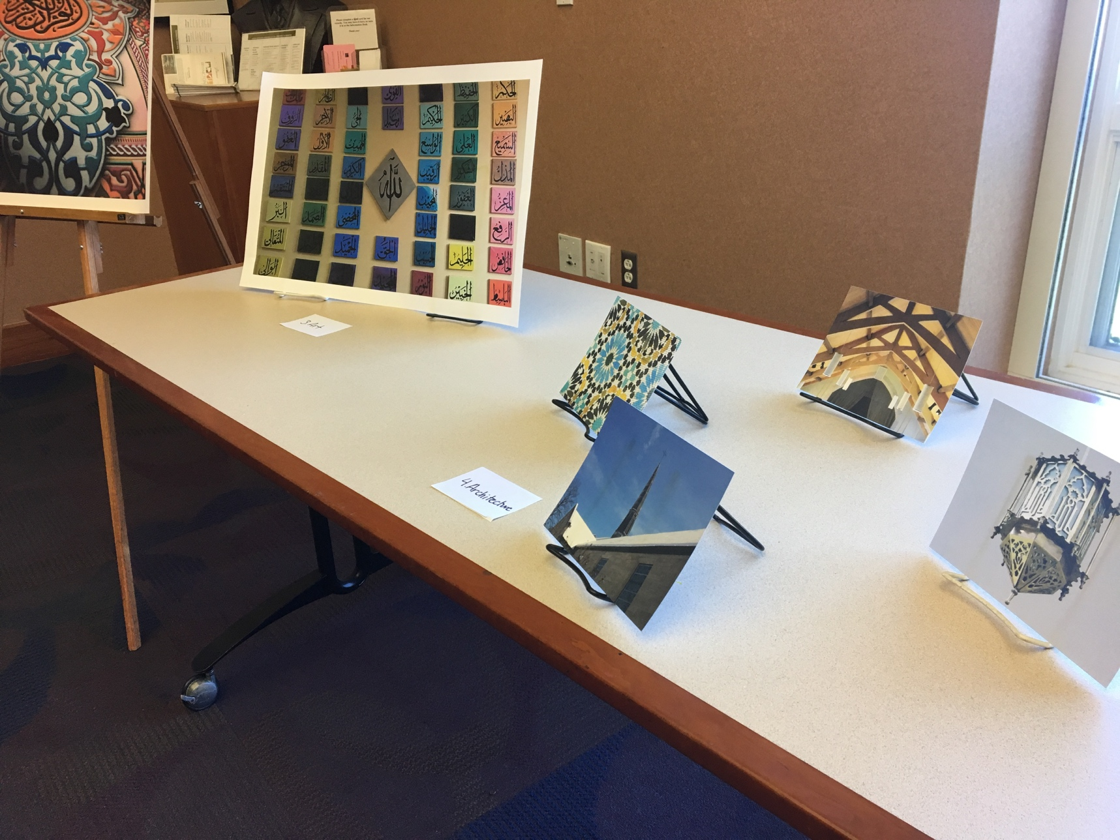
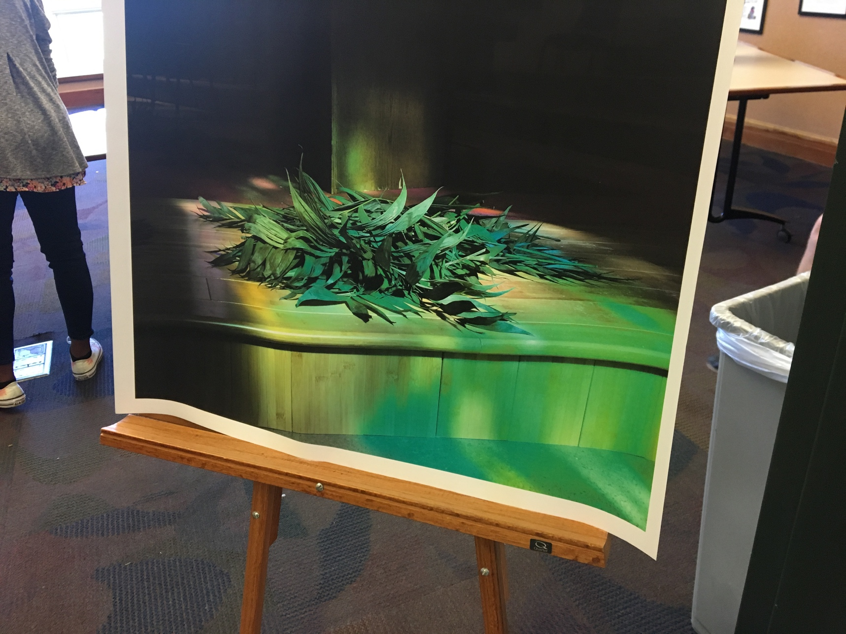
NOT SO DIFFERENT Youth PHOTO PROJECT

Slide 15
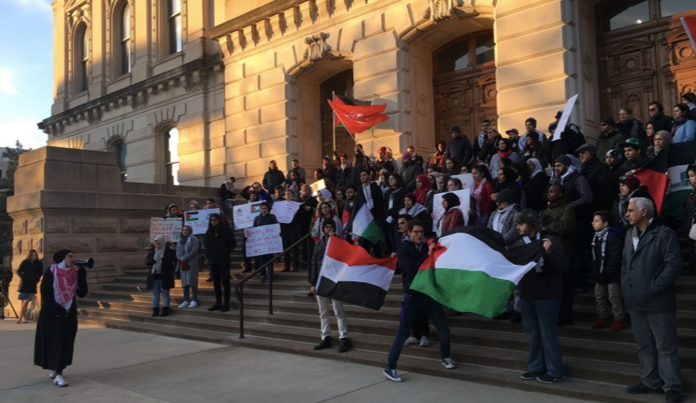
Muslim youth collective
Empowering Muslims to lead the resistance against Islamophobia, racism, and all systems of oppression

Slide 16

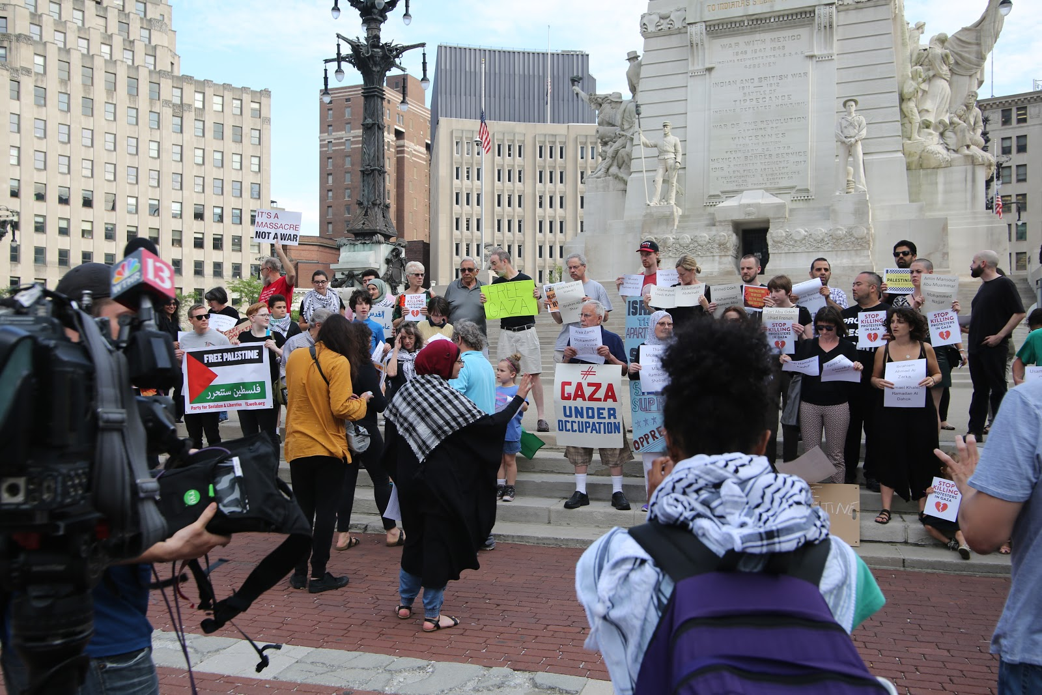
Who we are
Ahmed Abbas, AFSC Intern
Interested in connecting the anti-war struggle abroad, and the anti-racist struggle at home
Umaymah Mohammad, AFSC Intern
Interested in creating greater frameworks surrounding Islamophobia, Palestine, and anti-racist efforts through accessible and pragmatic means

Slide 17

Our goals
Launch a Muslim Youth Collective
Conduct the First Muslim-Only Training around Islamophobia
  Two part 4 hour trainings
    Defining, understanding, historicizing Islamophobia
    Liberal Islamophobia
    Moving from individual understanding to a systemic level understanding
    Narrative shifting
    Brainstorming how to combat Islamophobia in Indianapolis
Allows us to work through internalized Islamo-
phobia
Centers Muslims and provides them tools to talk about and resist anti-Muslim racism
Provides a safe space where Muslim understanding of anti-Muslim racism is the most important

Slide 18
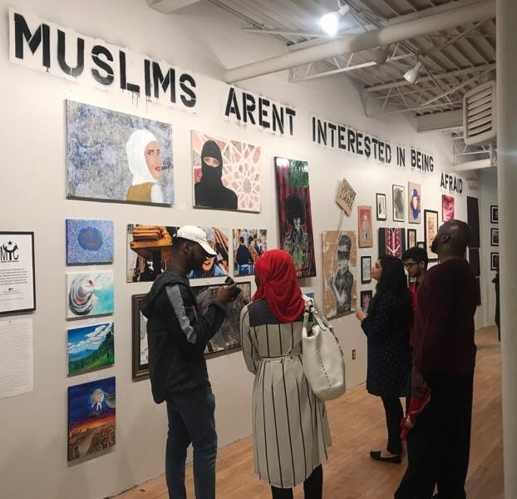
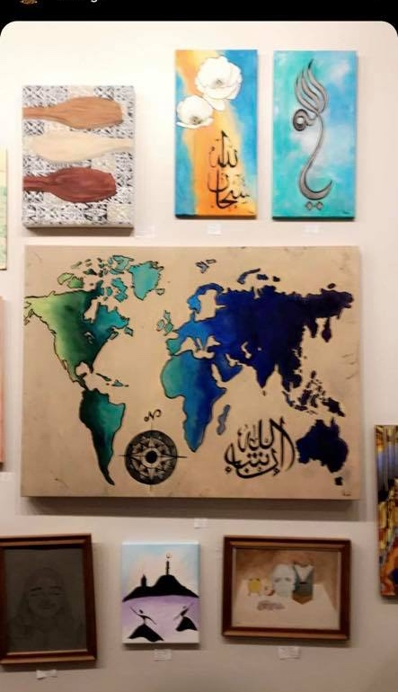
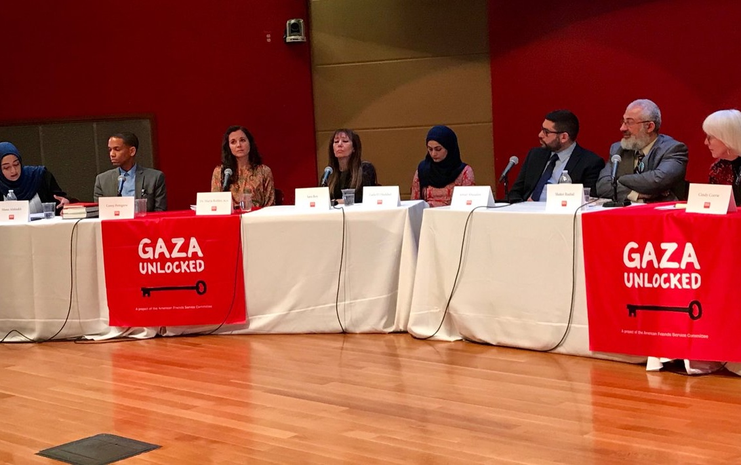
How we do what we do
1. Islamophobia Trainings and Community Advocacy
Provide a framework which discusses the overarching themes, concepts, and myths of Islamophobia
Focusing since December on Muslim communities rather than ally trainings alone
Shifting the focus to the causes of Islamophobia, especially war, and not simply examples of Islamophobia
Creating trainings and frameworks to challenge bigotry in the Muslim community
Make sure we emphasize an intersectional and holistic understanding of Islamophobia so as not to perpetuate systems of oppression such as: liberal Islamophobia, Zionism, anti-blackness, homophobia, etc.
2. Palestine Advocacy
Providing space for Palestinian voices as well as a more equitable discourse surrounding the colonization and occupation of Palestinian land

Slide 19
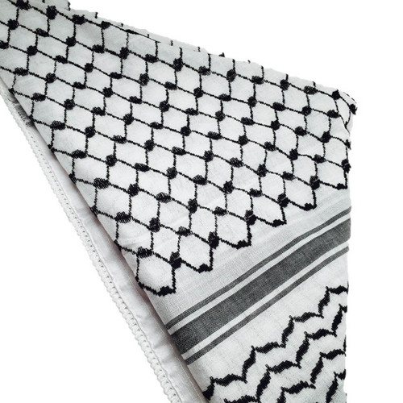
What we have done
In the last six months, the Muslim Youth Collective has:
Trained over 100 Muslims in Islamophobia trainings
Created curriculums, led press conferences, and fostered resistance against the Muslim Ban
Led rallies, teach-ins, vigils, and solidarity fasts for Palestine
  Worked with ally organizations on campuses, such as the Black Student Union, Native American Student Alliance, Students for Justice in Palestine, and Dreamer’s Alliance: United as One to foster discussions about the intersections of resistance
  Traveled to universities, such as IU-Bloomington and University of Notre Dame and DePauw, to train allies
  Challenged unjust surveillance of the Muslim community by facilitating dialogues with Muslim leaders, meeting with Congressman Andre Carson, and resisting racist policies.

Slide 20
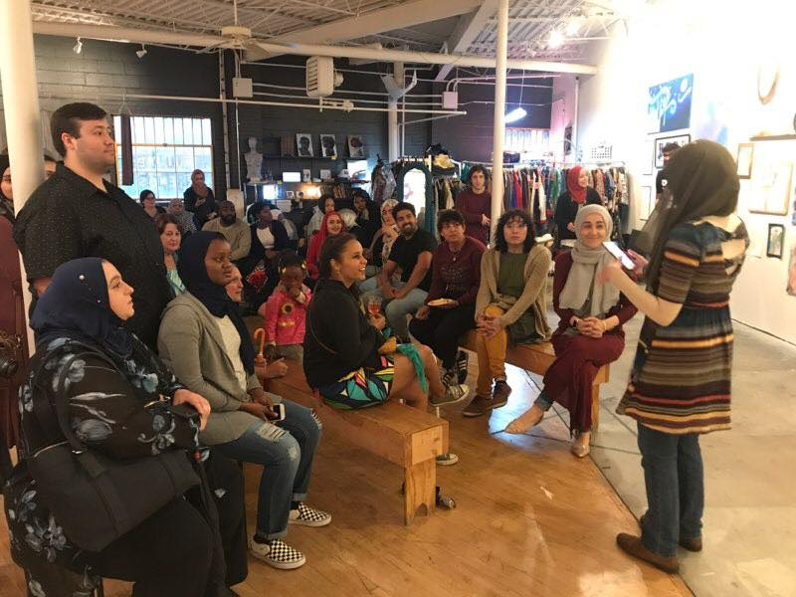
HOW YOU CAN HELP
Social Media
Like us on Facebook (Muslim Youth Collective - Indianapolis) and Instagram (@muslimyouthcollective.indy)
Partnering
Contact us to partner with your religious group, university, or organization so we can create greater bonds and linkages in the Indianapolis community!

Slide 21
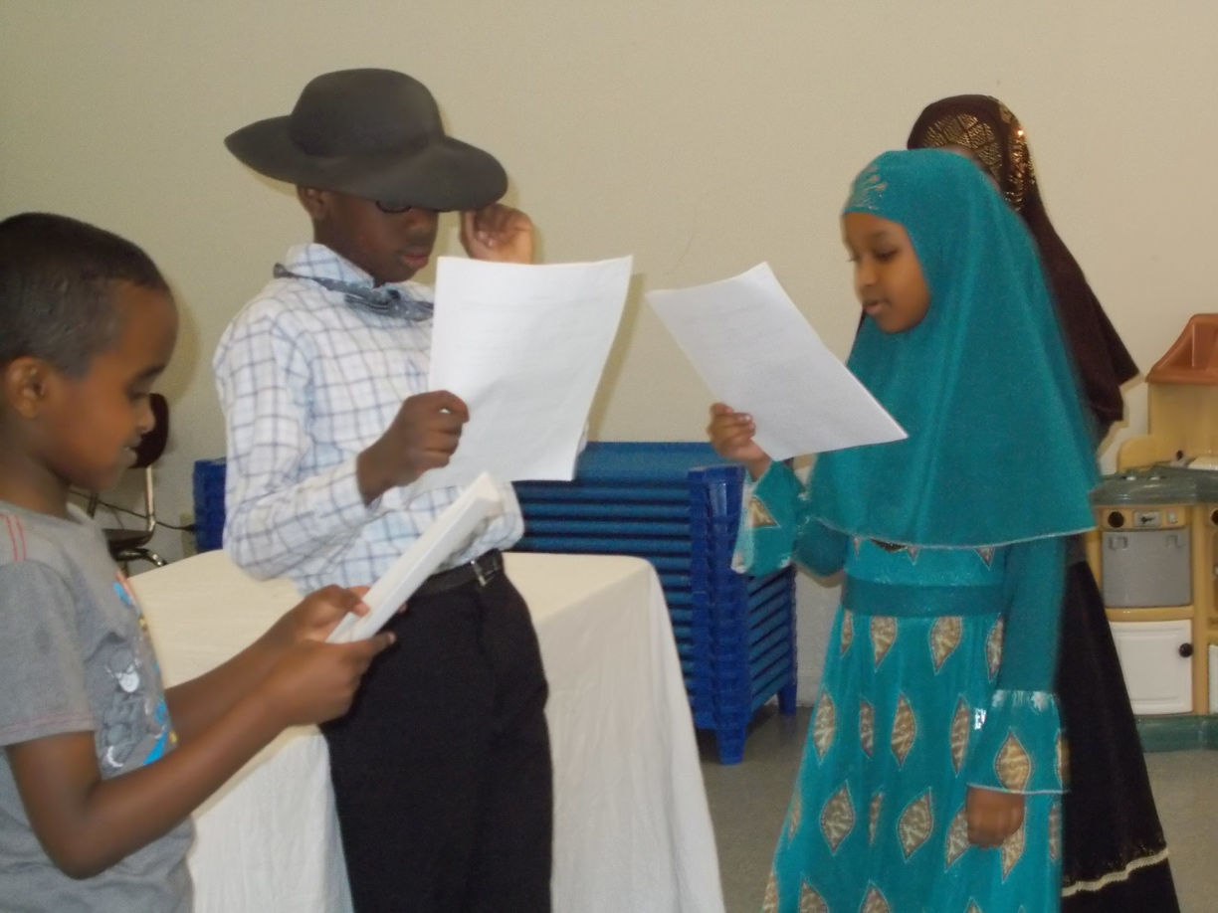
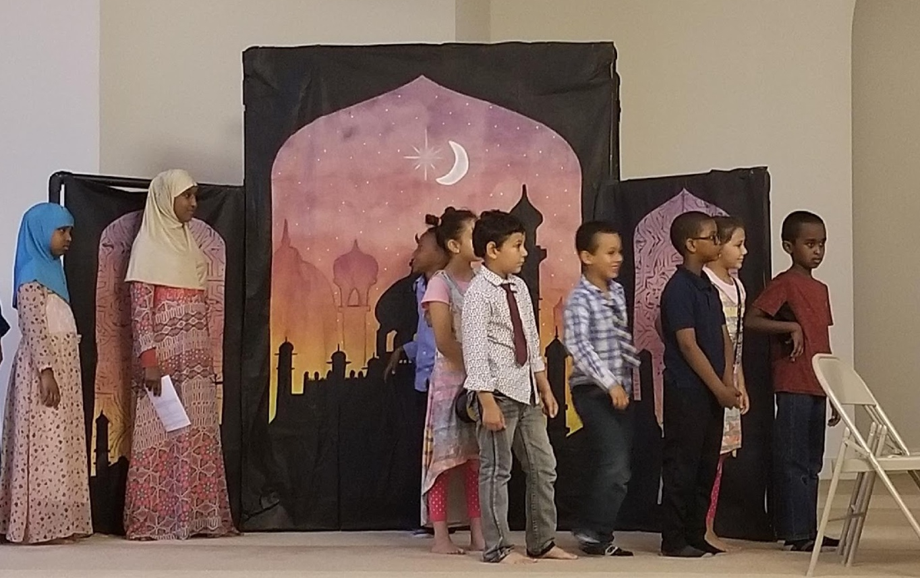
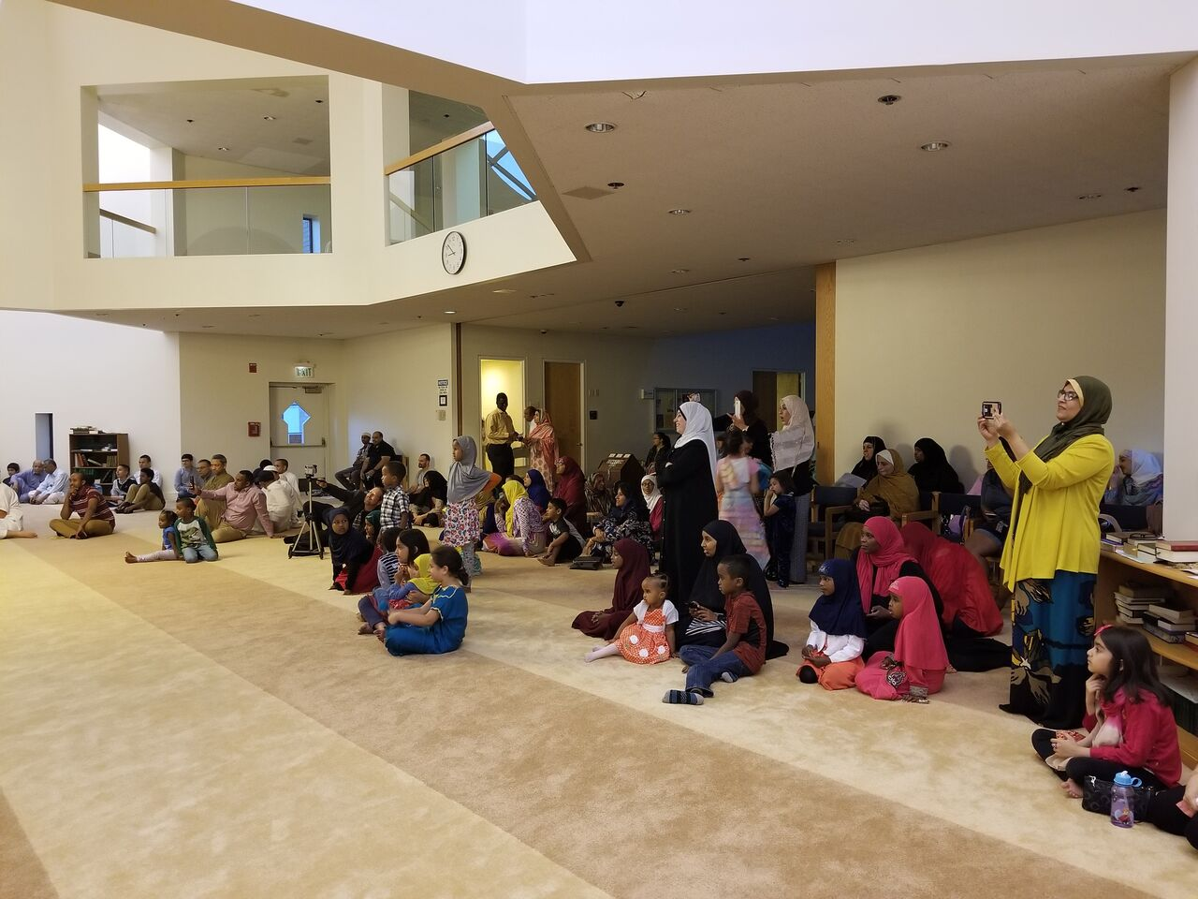
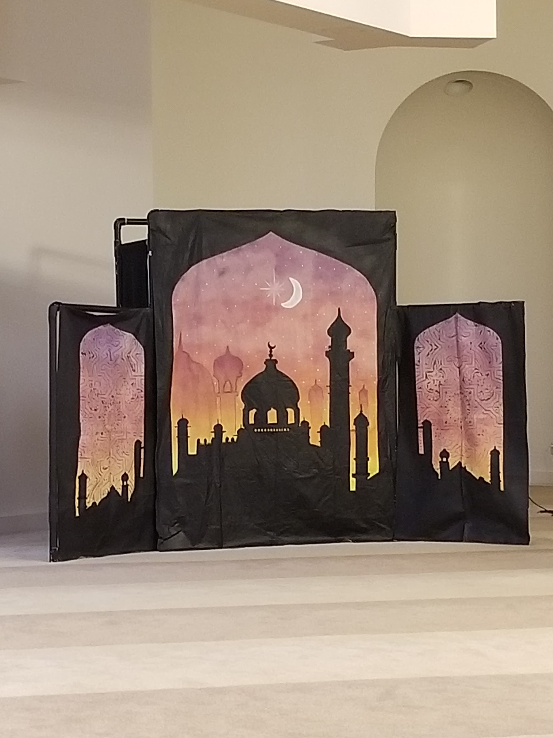
ISLAMIC FOLKLORE PROJECT
Ms. Hadeiyah Ameen Prof. Kristopher D. Steege
Working with local Muslim and non-Muslim schools, team developed a workshop experience for children combining Islamic folklore, theatre, and art. One of the plays was “The Hungry Coat.”
Notes:
*Change to Spring Fun for southern Hemisphere
Include pictures of the first term of school. Students working together/students reading books/working on projects or art, etc.

Slide 22
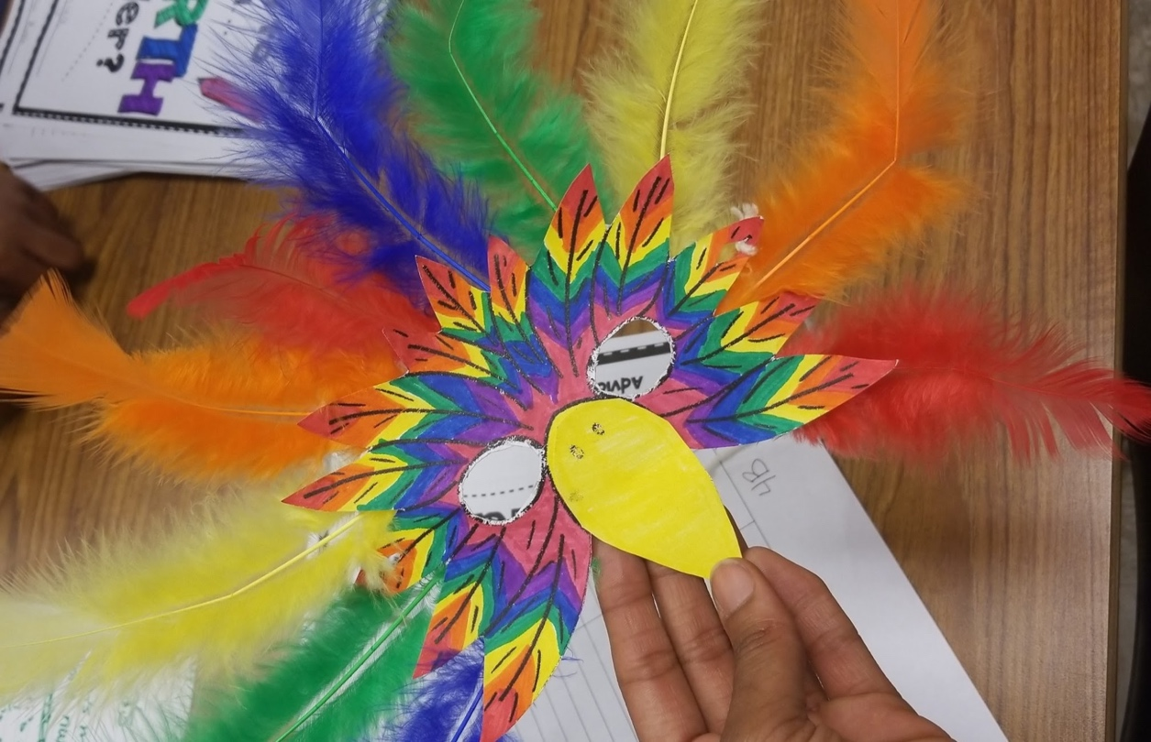
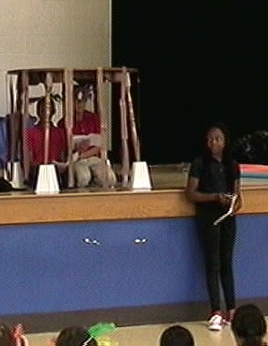
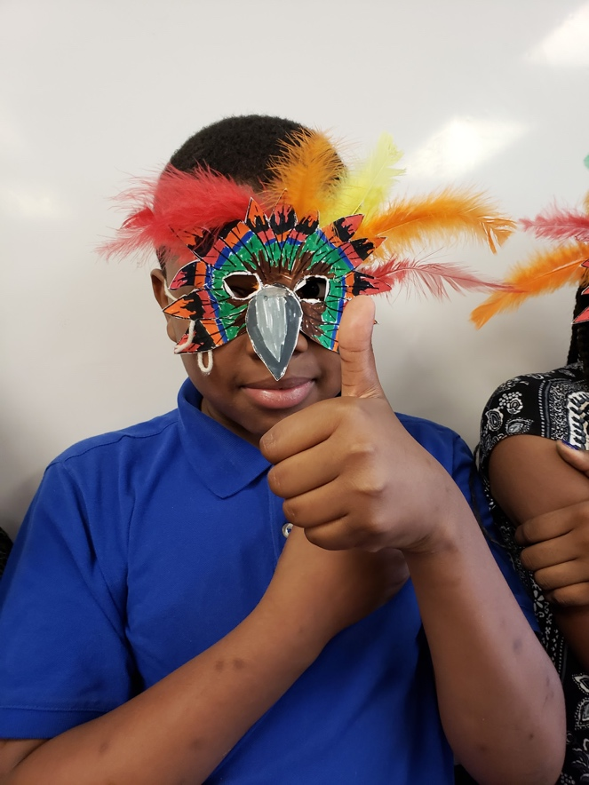
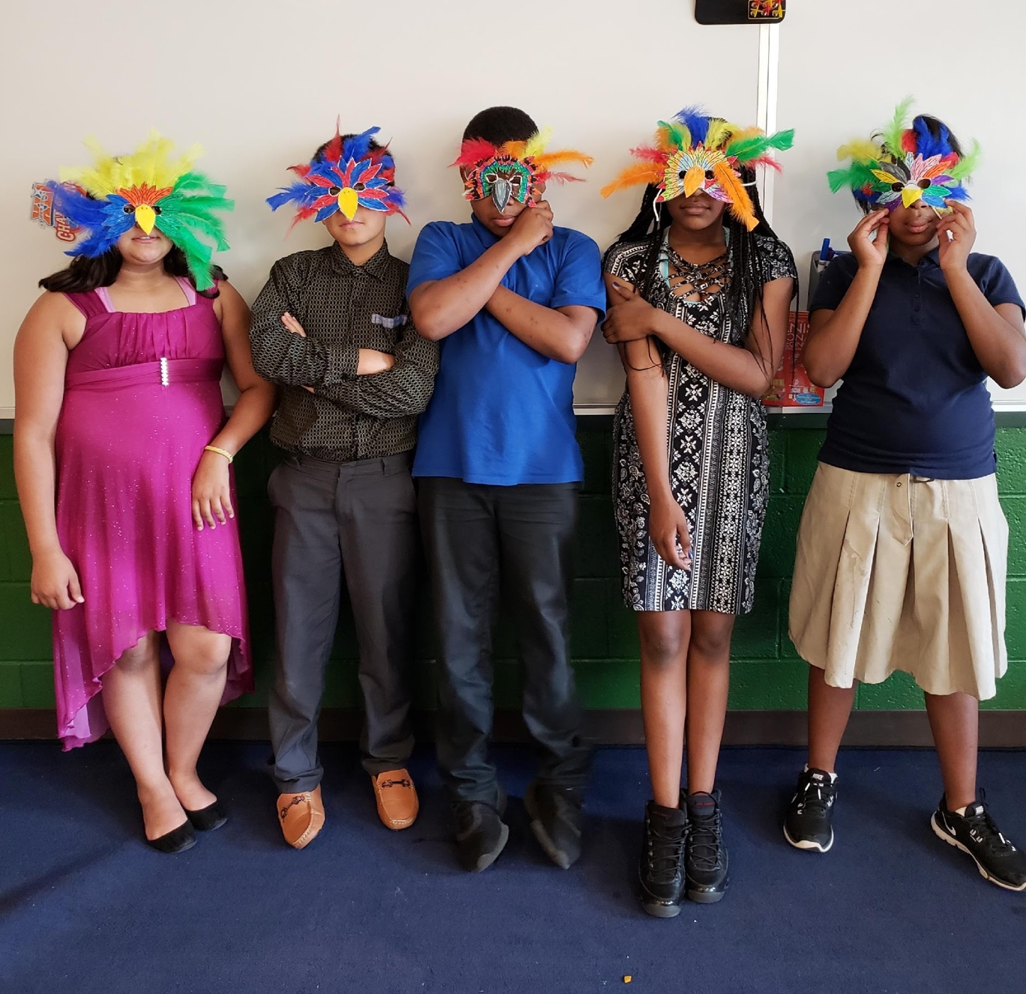
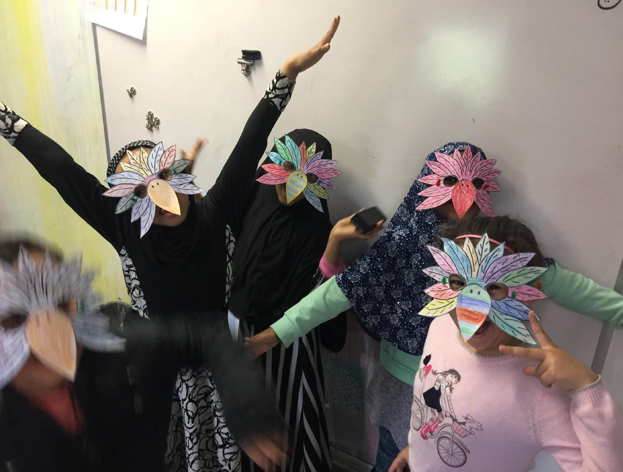
ISLAMIC FOLKLORE PROJECT
Ms. Hadeiyah Ameen Prof. Kristopher D. Steege
The Parrot’s Wish
Notes:
*Change to Spring Fun for southern Hemisphere
Include pictures of the first term of school. Students working together/students reading books/working on projects or art, etc.

Slide 23
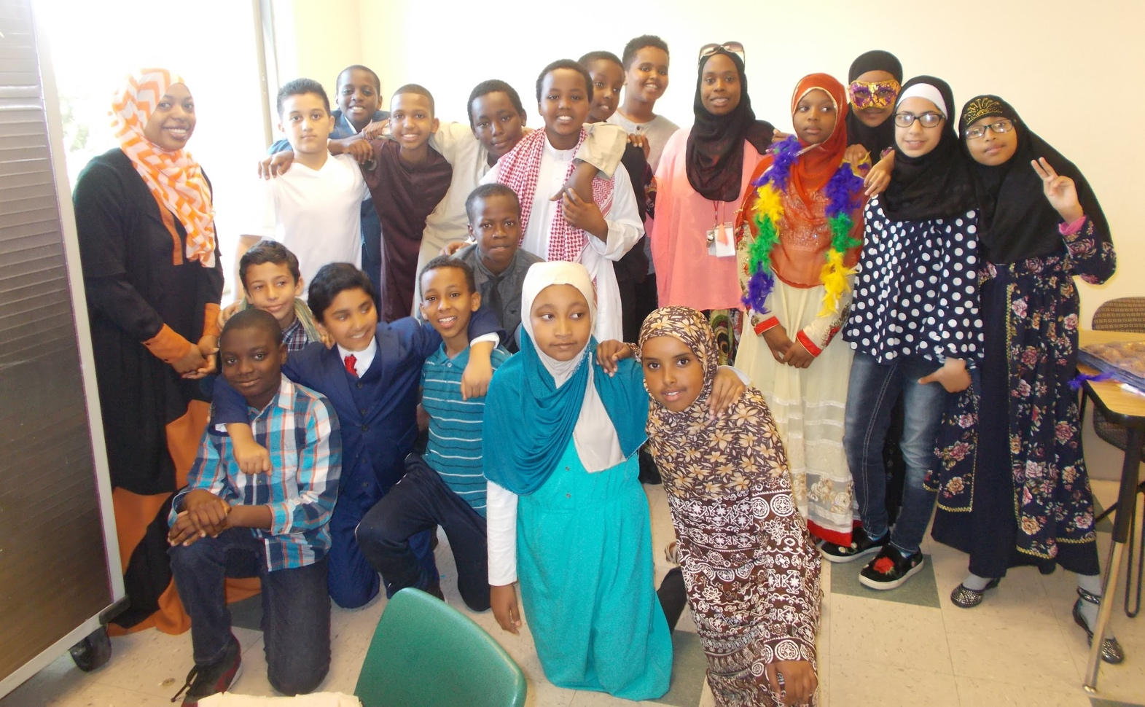
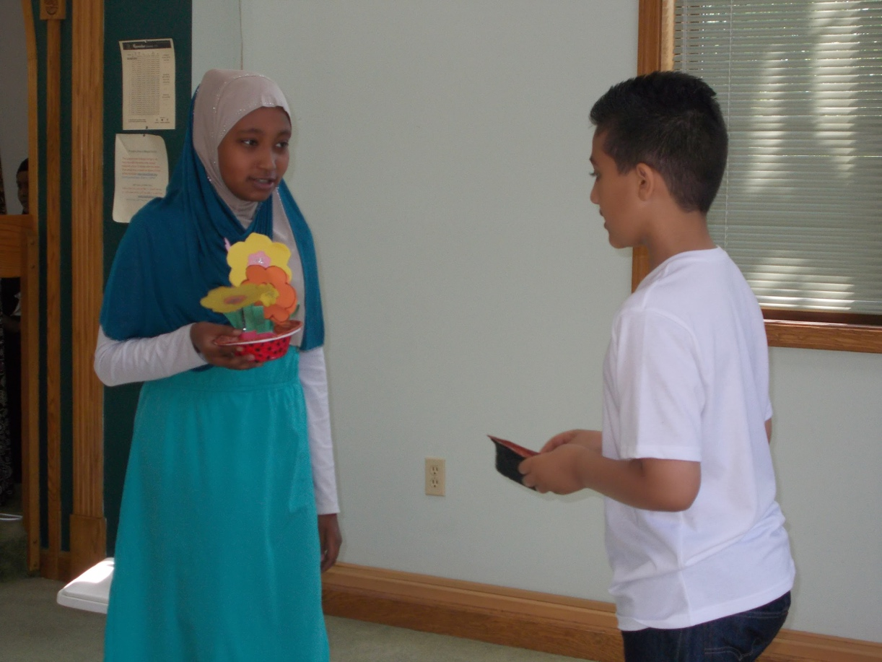
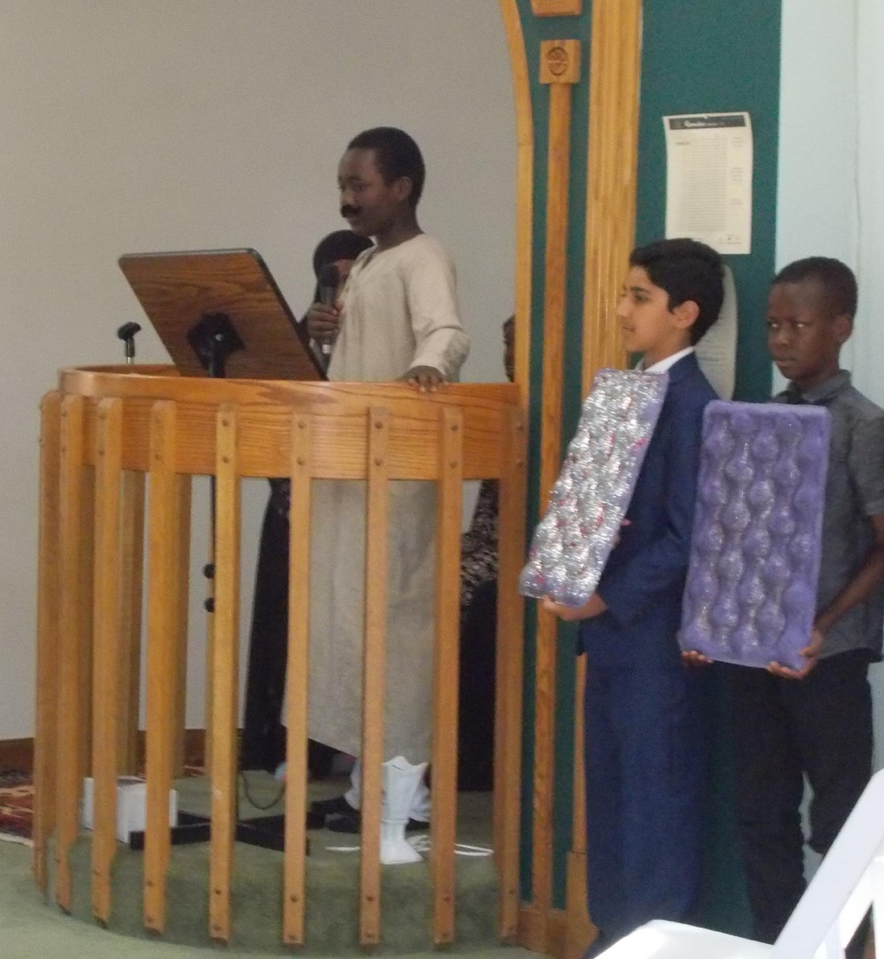
ISLAMIC FOLKLORE PROJECT
Ms. Hadeiyah Ameen Prof. Kristopher D. Steege
The Emperor and the Seed
Notes:
*Change to Spring Fun for southern Hemisphere
Include pictures of the first term of school. Students working together/students reading books/working on projects or art, etc.

Slide 24
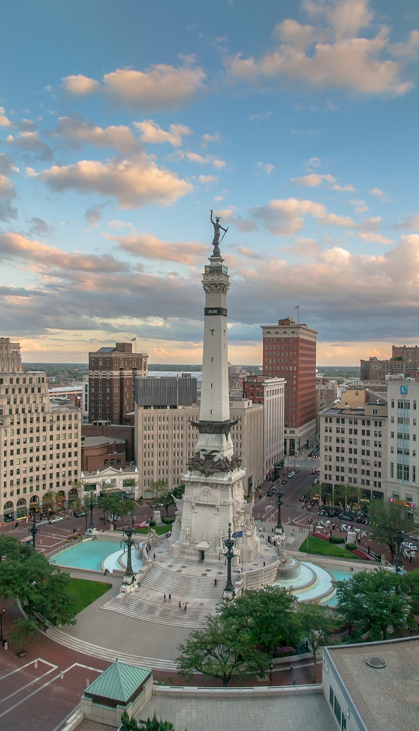
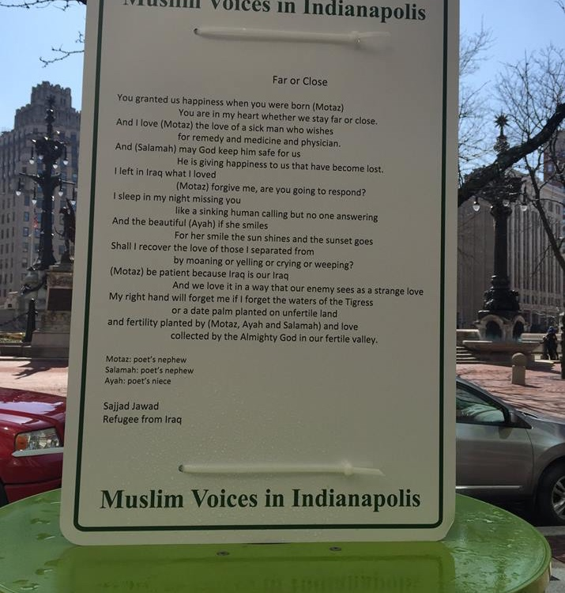
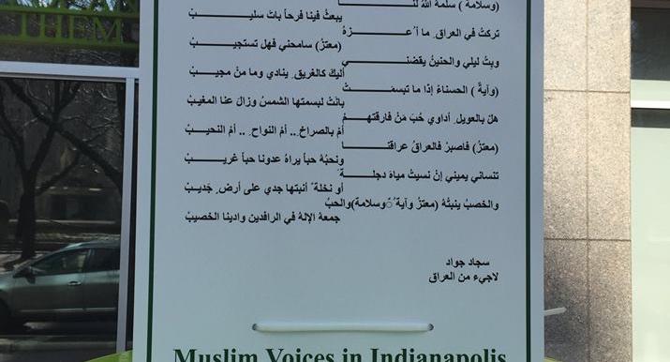
Brick Street Poetry
Muslim American Poetry on
Monument Circle
Sajjad Jawad, poet
Catholic Charities

Slide 25
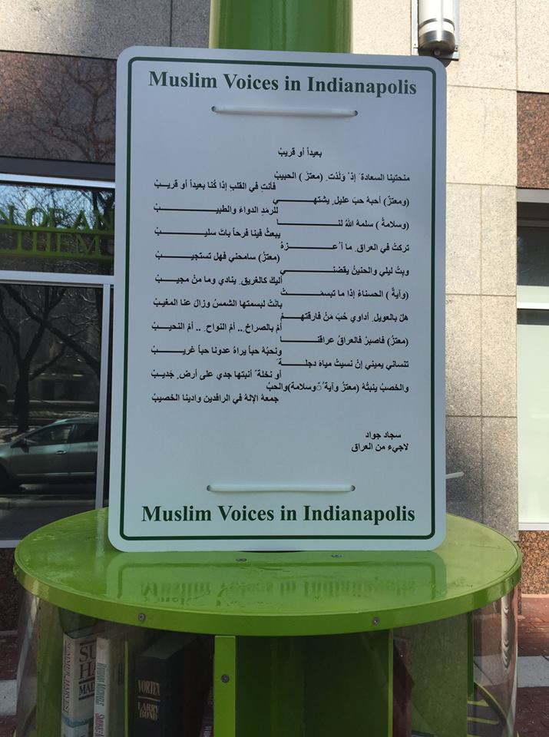
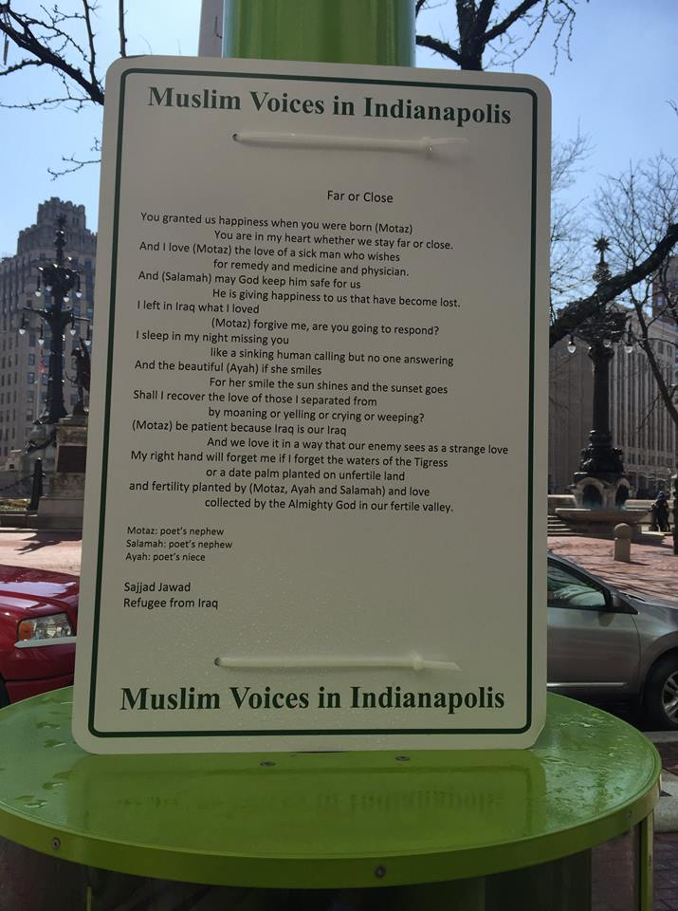

Slide 26
#STOPISLAMOPHOBIA

Slide 27
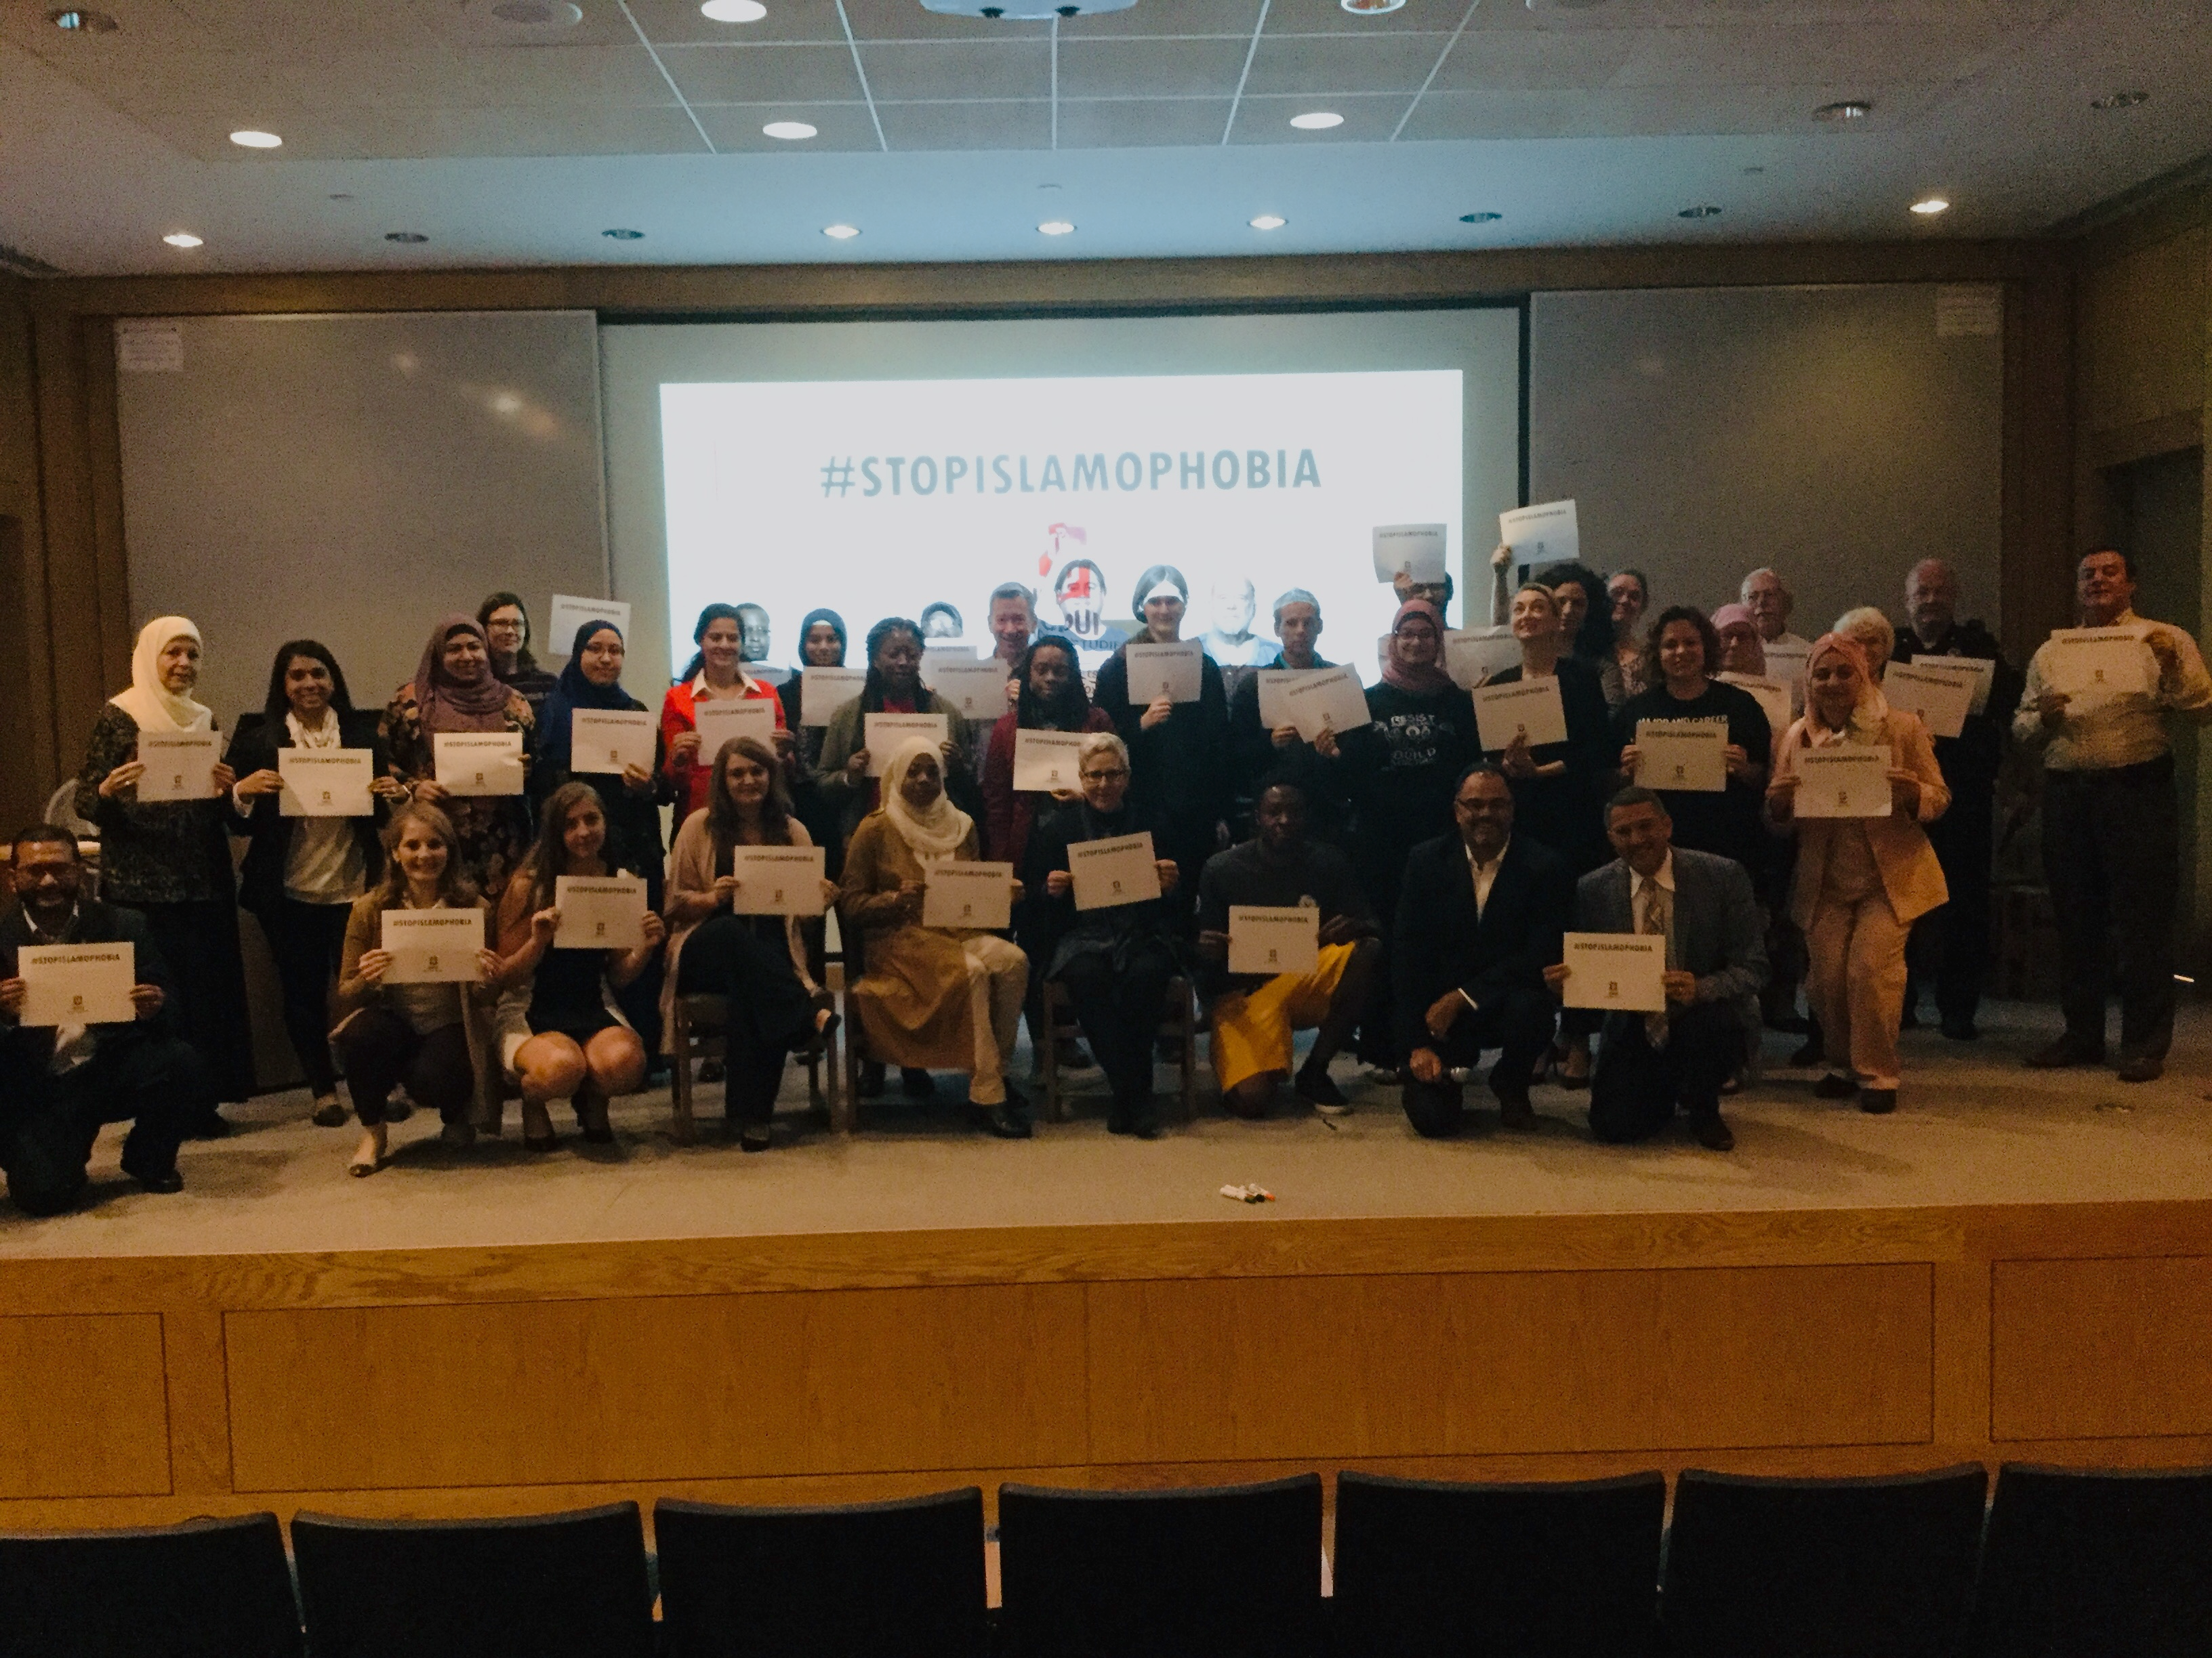

Slide 28


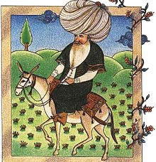

networking
Meet & Greet
Exchange Contact Info
Brainstorm
Make a Pledge

Slide 29
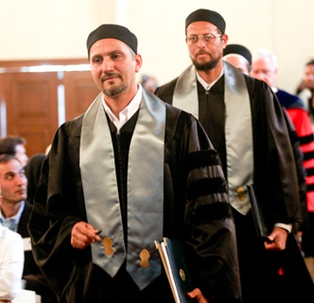
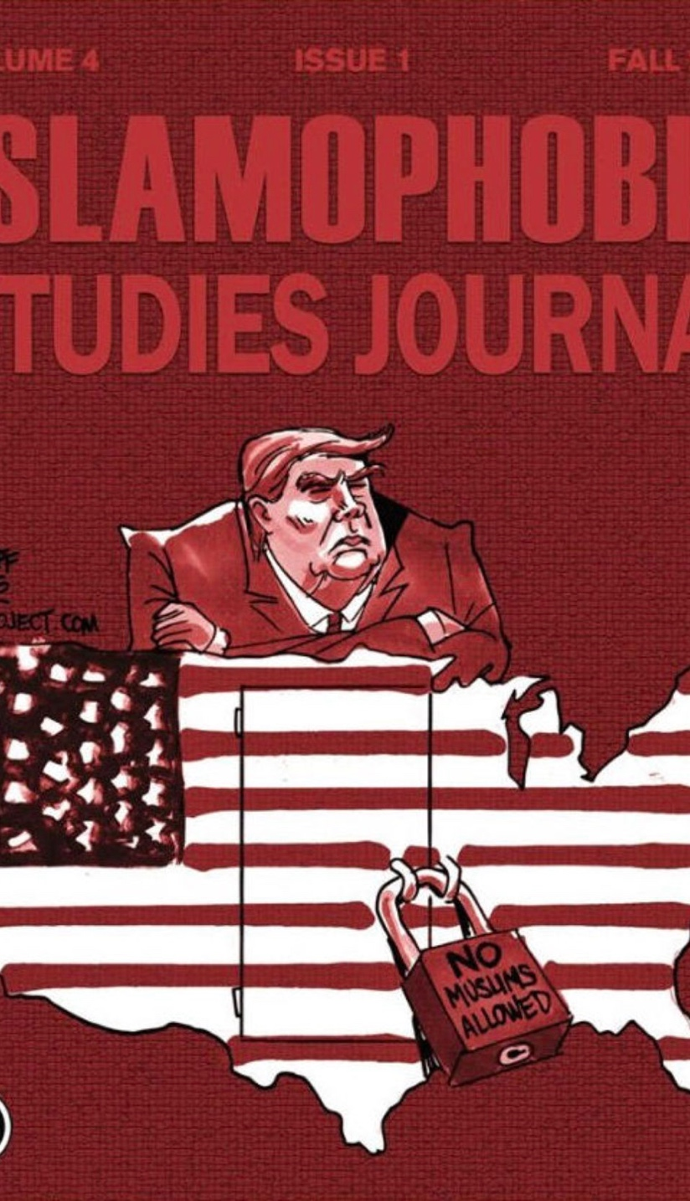


Dr. hatem bazian
The Roots of Islamophobia—and What You Can Do About

